Slide 1

Quantum Machine Learning
Summer Internship 2024, IISER Bhopal
Rohit Patnaik, Email: rohit21@iiserb.ac.in, Department of Physics,
IISER Bhopal
Supervisor: Dr. Kuntal Roy, EECS Department, Email: kuntal@iiserb.ac.in

Slide 2
Corporate Credit Rating Classification
using Quantum k-nn Algorithm

Slide 3
Contents
Corporate Finance and Credit Rating
Credit Rating
Key Financial Metrics
Designing a Quantum K-NN Classifier Model
Overview of Classical K-NN Algorithm
Steps to Build a Q-knn Classifier
Classical Data Pre-Processing
Quantum State Encoding
Building a Quantum Circuit: Swap Test
State Measurement
Classical Post-Processing
Model Evaluation

Slide 4
Corporate Finance and Credit Rating: A Brief Overview

Slide 5
Credit Rating
Corporate credit ratings, issued by specialist agencies, provide an assessment about the credit worthiness of a company and acts as a pivotal financial indication to potential investors.
It helps provide investors with a concrete idea about the risk associated with the company’s credit investment returns. Every company aims to attain a good credit rating for seeking more investment and lower debt interest rates.
Most of the credit rating agencies have a unique discrete ordinal rating scale. The rating scale of the S&P is: {AAA, AA+, AA, AA−, A+, A, A−, BBB+, … , CC, C, D} – a total of 22 grades that are ordered from AAA, the most promising one to D, the most risky one.

Slide 6
Credit Rating (continued..)
S&P broadly classifies the companies with rating higher than BB+ as investment grade companies and others as junk grade companies.
Credit ratings are mostly determined by financial ratios coming from balance sheets, income statements, and cash-flow statements.
Balance sheets provide a snapshot of assets, liabilities, and equity at a point in time; income statements detail revenue, expenses, and profit over a period; while cash flow statements track cash movements from operations, investments, and financing activities, revealing liquidity.

Slide 7
Key Financial Metrics
Financial metrics are vital for credit ratings, as they gauge a company's financial stability and ability to meet debt obligations. Strong metrics indicate lower risk, leading to higher credit ratings and more favorable borrowing terms. Some of the key financial metrics used in this project are:
Current Ratio: Measures a company's ability to cover short-term liabilities with short-term assets.
Debt/Equity Ratio: Indicates the proportion of a company's debt to its shareholders' equity.
Gross Margin: Represents the percentage of revenue that exceeds the cost of goods sold.

Slide 8
Key Financial Metrics (continued..)
Asset Turnover: Assesses how efficiently a company uses its assets to generate sales.
Return on Equity (ROE): Shows the profitability relative to shareholders' equity.
EBITDA: Reflects earnings before interest, taxes, depreciation, and amortization, indicating operational profitability.
Net Profit Margin: Indicates the percentage of revenue that becomes net profit after all expenses.
Free Cash Flow: Represents the cash generated after accounting for capital expenditures, available for debt repayment, dividends, or reinvestment.

Slide 9
Designing a Quantum K-NN Classifier Model

Slide 10
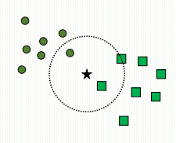
Overview of Classical K-NN Algorithm
The classical k-nearest neighbors (K-NN) algorithm is a straightforward yet effective approach in machine learning for both classification and regression tasks.
During training, it memorizes all available labeled data points. To classify a new data point, K-NN calculates the distance (typically Euclidean) between the new point and all points in the training set. The class of the new data point is determined by majority voting among its k nearest neighbors.
Euclidean

Slide 11
Overview of Classical K-NN Algorithm (ctd.)
The parameter k influences the algorithm's decision-making by specifying the number of neighbors considered.
While K-NN is easy to understand and implement, it can be computationally intensive for large datasets due to its reliance on calculating distances to all training examples.
Therefore, we will use a Quantum KNN Model, which offers a significant speedup over Classical KNN by leveraging quantum principles to simultaneously evaluate distances from multiple quantum states, enhancing computational efficiency and potentially offering advantages in processing large datasets.

Slide 12
Steps to Build a Q-knn Classifier
The key steps in constructing a Quantum K-Nearest Neighbors (Q-knn) classifier include:
Classical Data Pre-Processing: Transform and clean raw data to ensure it meets the requirements for input into the quantum algorithm, such as normalization and feature scaling.
Data Encoding and Quantum State Preparation: Convert classical data into quantum states, typically through methods like amplitude encoding, to prepare them for quantum processing.
Building a Quantum Circuit for Distance Evaluation: Design a quantum circuit that calculates the distance between quantum states using SWAP Test¹, crucial for similarity evaluation in quantum k-nearest neighbors (kNN) classification.

Slide 13
Steps to Build a Q-knn Classifier (ctd..)
State Measurement: Measure the final quantum state after computation to obtain classical information that represents the outcome of the quantum algorithm.
Classical Post-Processing: Convert quantum measurement outcomes into classical data representations, such as class labels, to complete the classification process.
Model Evaluation: Evaluate the performance of the quantum kNN classifier using standard metrics like accuracy, precision, recall, and F1-score to assess its effectiveness in classifying data based on quantum states.

Slide 14
Classical Data Pre-Processing
In classical machine learning, data preprocessing involves:
Removing Duplicates: Eliminate duplicate records to prevent bias in the model.
Missing and Zero Value Treatment: Handle missing data by imputation or removal to maintain dataset integrity. And address zero values appropriately, especially if they may represent missing data or require special handling.
Feature Selection: Use expertise in the specific domain (finance) to manually select features based on their relevance and significance to the problem.
Scaling the Data: Normalize or standardize features to ensure all variables contribute equally to the model.

Slide 15


Quantum State Encoding
Next, we encode the test sample features into a quantum state using Amplitude Encoding.
Amplitude Encoding is a technique in quantum computing used to represent classical data within a quantum state. In this method, the features of a data sample are encoded into the amplitudes of a quantum state.
Each feature value corresponds to the amplitude of a specific basis state, hence for n features we use n qubits to encode the feature values.
Features
Qubits

Slide 16

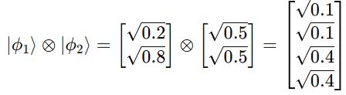
Quantum State Encoding (Example)
To illustrate amplitude encoding, consider a feature vector 𝑥 = [0.2,0.5,0.8,0.3]. Each feature x_{i} is encoded into a qubit state as: ∣ϕ_{i}​⟩ =
For example:
Then, the combined feature vector encoding is obtained by taking the Kronecker product (tensor product) of these individual states.
First, we combine ∣𝜙₁⟩ and ∣𝜙₂⟩:

Slide 17
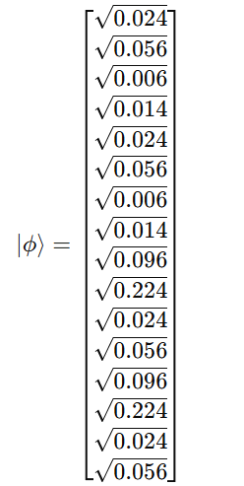
Quantum State Encoding (Example ctd.)
We combine this result with ∣𝜙3⟩, and so on till ∣ϕ4​⟩ to get the final state.
In a similar manner, we encode the entire training set along with the indices of each vector into a single superposition state.
We then verify the validity of these state vectors and initialize these quantum states into quantum registers using Qiskit's `initialize` method.

Slide 18
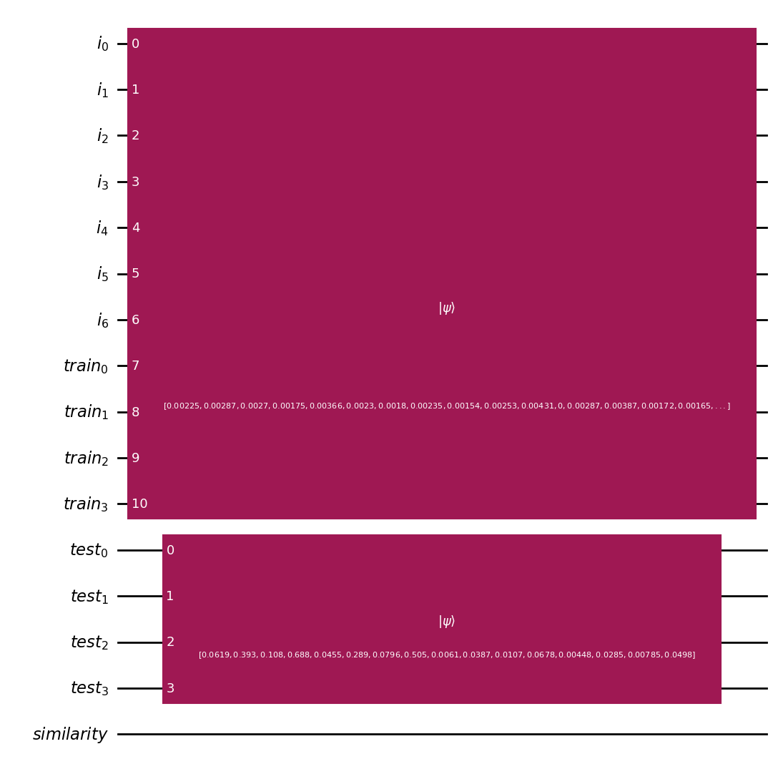
Final Encoded Circuit Diagram
Index Register
Training
Feature
Register
Test
Feature
Register
Similarity
Register

Slide 19
Building a Quantum Circuit: Swap Test
The SWAP test is a straightforward yet powerful quantum algorithm used to assess the similarity between two quantum states. We use one ancillary qubit, m qubits for the m training features, and another m qubits for the m test features.
Designing the quantum circuit is a simple 3-step process. First, a Hadamard gate is applied to the ancillary qubit. Next, we iteratively apply controlled-SWAP gates to the corresponding training and test features with the ancillary qubit as the control. Finally, we apply another Hadamard gate to the ancillary qubit to complete the Swap test circuit.
When measured, this circuit provides us with the inner product of the features being compared, which serves as an indicator of their similarity.

Slide 20
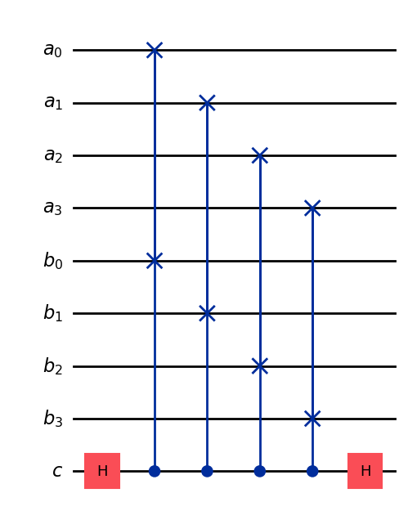
Circuit Diagram of Swap Test
Training
Feature
Qubits
Test
Feature
Qubits
Ancillary Qubit
/ Similarity
Register

Slide 21
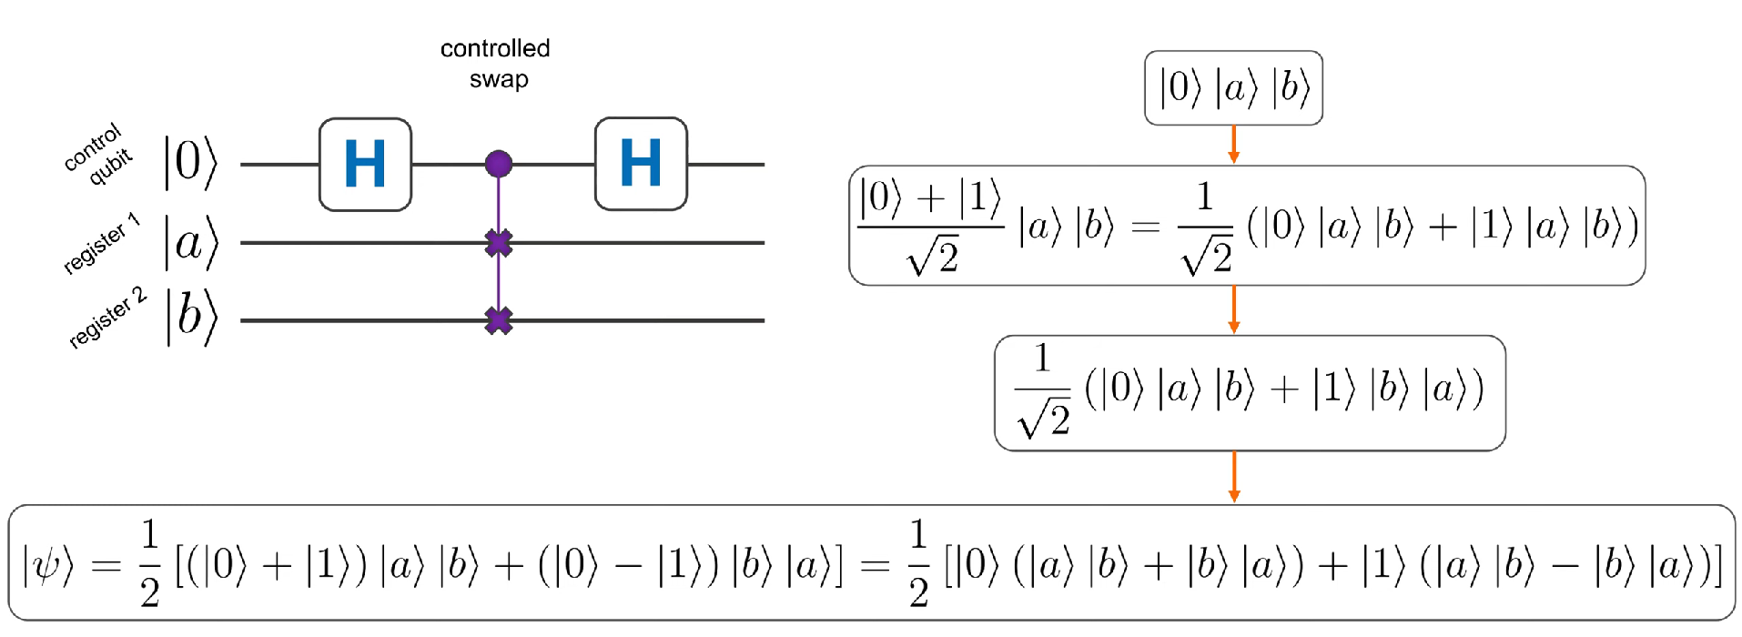
Swap Test Explanation
Let's consider step by step how the state changes with an example involving two states, 𝑎 and 𝑏, for which we will determine the similarity using the SWAP test.
Initial State
H
CSWAP
H

Slide 22
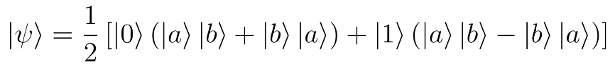
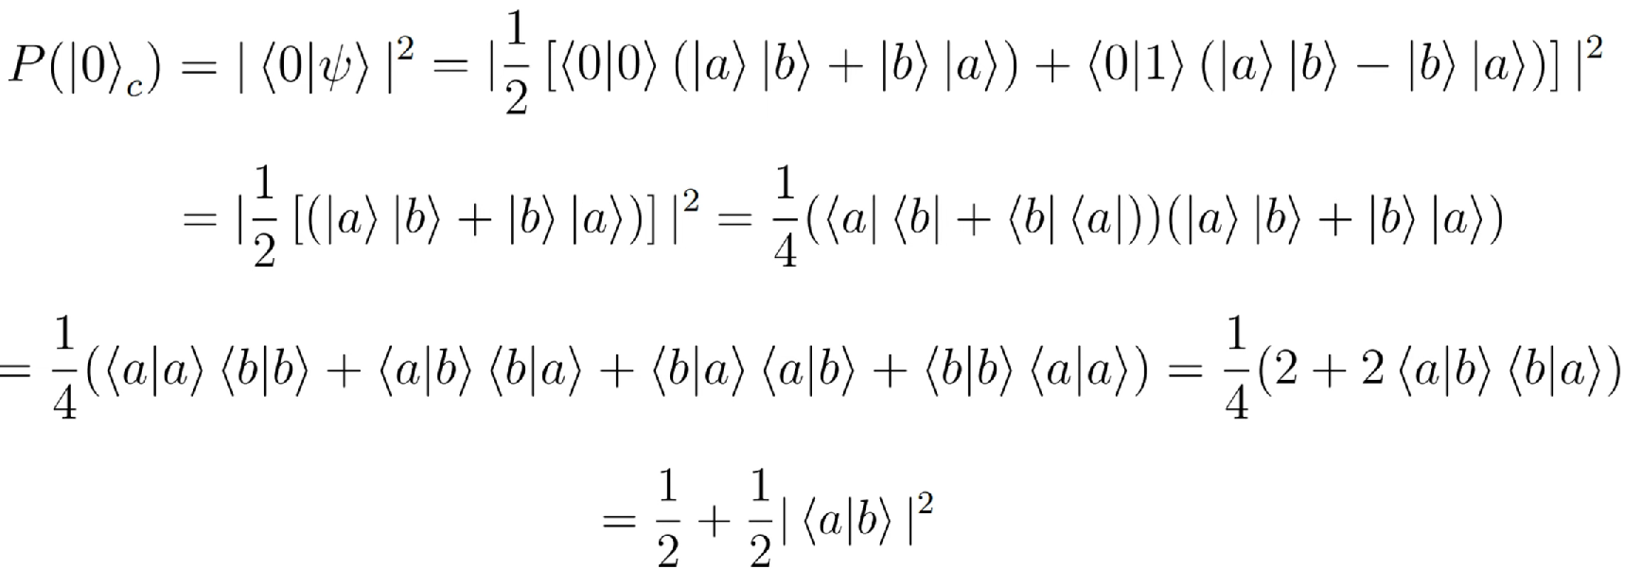
Swap Test Explanation (ctd.)
So, the final state of the system before measurement is:
Now if we perform the measurement on the ancillary qubit, the probability to measure the state in state 0 is:

Slide 23
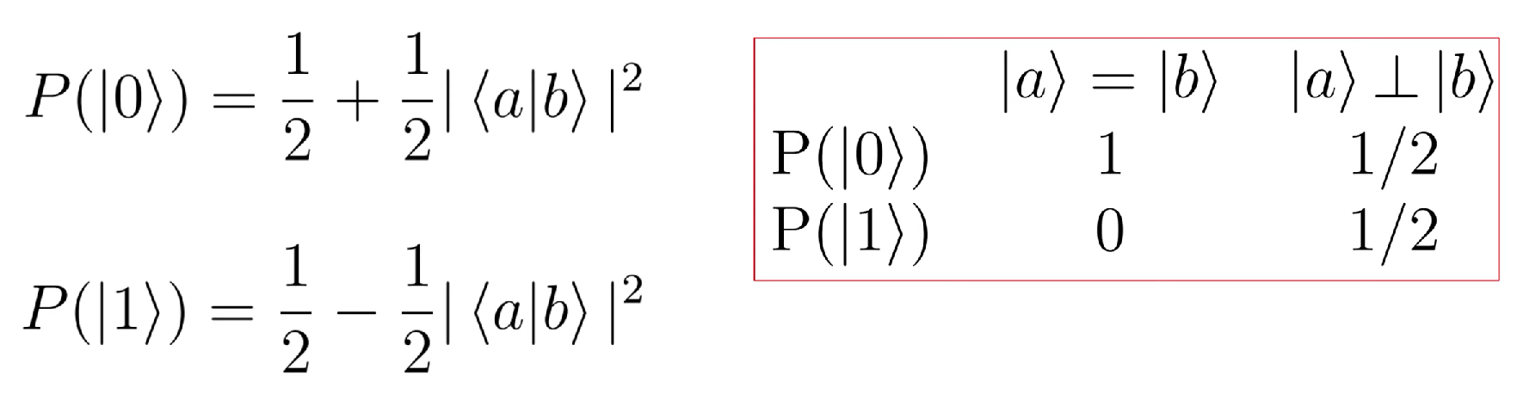

Swap Test Explanation (ctd.)
We can similarly find the probability of measuring the ancillary qubit in state 1 to finally obtain:
Now, we can easily obtain the inner product, which serves as our indicator for similarity, as:

Slide 24
State Measurement
Now that the entire circuit is complete, we will add a classical measurement register and measure the qubits representing the index of the training vectors and the qubit representing the similarity.
When we measure these qubits, the index qubits—which were in a superposition state of all the training vectors—will collapse to a single training vector index and its features. Then, we will measure the similarity between this training vector's features and the test vector’s features using the swap test, and obtain the similarity output from the similarity register measurement.
We repeat this measurement multiple times to determine the similarity between the test state and all of the training states.

Slide 25
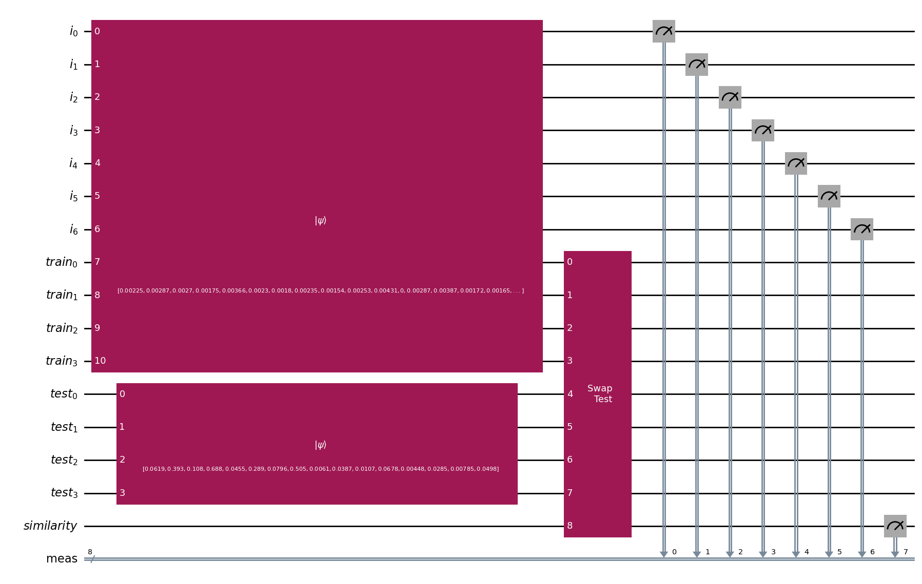
Circuit Diagram
Index Register
Training
Feature
Register
Test
Feature
Register
Similarity
Register
Measurement
Register

Slide 26
Classical Post-Processing
From the measurement count results, we first calculate the probability of measuring the similarity register/ancillary qubit in state ∣1⟩. Using this probability, we then determine the similarity or inner product using the formula: Similarity = 1 - 2*P(1).
After obtaining the similarity scores, we sort the training vector indices in descending order based on their similarity scores. Then, we select the 'k' indices with the highest similarity scores.
Next, we perform a majority vote among the 'k' selected training data points and assign the majority label to the test data point.
Inner Product

Slide 27
Model Evaluation
We repeat this procedure, running the circuit for each test data point individually. By encoding all the test data points one by one, we find the 'k' nearest neighbors for each test data point and assign labels to them accordingly.
Finally, we evaluate the model using the accuracy score, which is defined as:
Number of correctly classified test points
Accuracy =
Total number of test points

Slide 28
Summary and Future Work
In this project, we used the corporateCreditRating² dataset, selecting 150 companies and four key features to train our quantum KNN model, utilizing the swap test. The model achieved an 80% accuracy, highlighting the promising potential of quantum techniques in credit risk assessment.
For future work, we could develop a multi-class classification model to provide exact credit ratings for companies using quantum machine learning methods. This would enhance the accuracy and detail of credit assessments by leveraging advanced quantum techniques.

Slide 29
References
Basheer, A., Afham, A., & Goyal, S. K. (2020). Quantum $ k $-nearest neighbors algorithm. arXiv preprint arXiv:2003.09187.
https://ssrn.com/abstract=4163283 or https://www.kaggle.com/datasets/kirtandelwadia/corporate-credit-rating-with-financial-ratios

Slide 30
Thank You
Presented by: Rohit Patnaik
Supervisor: Dr. Kuntal Roy

